Slide 1
Internet Banking Application
What is mean by BFSI domain for Tester?
Banking Domain Knowledge for Testers,
What is Banking,
Types of Banks,
Types of Bank Accounts,
Types of Banking Products, and
Banking Terms.

Slide 2
Saving Banks
A savings bank is a financial institution whose primary purpose is accepting savings deposits and paying interest on those deposits.
e..g SBI, Union bank of India, etc
b) Commercial Bank
A commercial bank is a financial institution which accepts deposits from the public and gives loans for the purposes of consumption and investment to make profit.
e..g ICICI Bank, HDFC Bank, Axis Bank, Yes Bank, and Kotak Mahindra Bank.

Slide 3
c) Industrial Banks
A bank is a financial institution that accepts deposits from the public and creates a demand deposit while simultaneously making loans. Lending activities can be directly performed by the bank or indirectly through capital markets
e…g IDBI, Industrial Finance Corporation (IFC)
State Financial Corporations (SFCs)

Slide 4
d) Agricultural Banks
To finance the agricultural sector. They also help in land development.
A type of bank that lends money to farmers for longer periods of time and charges them less interest than other types of banks
e..g
e) Central / Federal / National Bank
e..g RBI

Slide 5
f) Co-operative Banks
Co-Operative Banks are small financial institutions that offer lending facilities to small businesses in both urban and non-urban regions. These are monitored and regulated by the Reserve Bank of India (RBI)
g) Exchange Banks
Exchange Banks are also called as foreign exchange banks and they are incorporated outside the country but carry out business in India.

Slide 6
Types of Bank Accounts
Savings accounts
Current Accounts
Recurring Deposit Account
Fixed Depostit Account
Certificates of deposit

Slide 7
1. Saving Account:
They are for people who want to keep their money in a safe place and earn interest at the same time. We don’t need a lot of money to open a savings account.
Features of the Savings account:
There is no limit to the number of times the account holder can deposit money in this account but there is a restriction on the number of times money can be withdrawn from this account.
The rate of interest that an account holder get varies from 4% to 6% per annum
There is no minimum that needs to be maintained for this type of an account balance
The savings bank account is mostly eligible for students, pensioners and working professionals

Slide 8
2. Current Account
The second type of bank account is the current bank account. These accounts are not used for the purpose of savings. Its main function is to satisfy the daily transaction.
Features of the Current account:
This type of bank account is mostly opened by businessmen. Associations, Institutions, Companies, Religious Institutions and other business-related works, the current account can be opened
There is no fixed number of times that money can either be deposited or withdrawn from such accounts
Overdraft facility is available for current bank accounts
There is no interest that is paid on such accounts

Slide 9
Recurring Deposit Account
Recurring Deposit account or RD account is a form of account wherein the account holder needs to deposit a fixed amount every month until it reaches the fixed maturity date.
The features of the Recurring deposit account
Any individual or an Institution can open a recurring deposit account either separately or jointly
Periodic or monthly instalments that need to be added can be as low as Rs.500/- or may vary from bank to bank
The range of months for which an RD account can be opened varies from 6 months to 120 months
The interest rate varies depending upon the bank you choose to open an account with
Premature withdrawal of the amount is permitted, provided a sum of amount is deducted as penalty

Slide 10
Fixed Deposit Account
FD or a fixed deposit account is type of account, the account holder needs to deposit a fixed amount of sum (as per their wish) for a fixed time period
Features:
this type of account, the account holder needs to deposit a fixed amount of sum (as per their wish) for a fixed time period
Banks pay interest on the fixed deposit account
Full repayment of the amount is not available before the maturity date.

Slide 11
Certificates of deposit
Before you invest in a certificate of deposit, it is necessary that you are entirely aware of what this money market instrument is all about
type of savings account usually issued by commercial banks, which restricts your access to the money you invest but offers much higher interest rates than those associated with regular savings accounts.
Mostly min limit is 1 lack… depend on bank..
Duration is also less as compared to fixed deposit account.

Slide 12
Types of Loans
Personal Loan
Home Loans
Bank Loans against Property
Business Loans:
Vehicle Loans:
Education Loans

Slide 13
Business Day: Any day on which offices of a bank are open to the public for carrying on substantially all of the bank’s business.
Cheque (future dated transaciton and BVT)
A written order instructing a financial institution to pay immediately on demand a specified amount of money from the check writer’s account to the person named on the check or, if a specific person is not named, to whoever bears the check to the institution for payment.

Slide 14
Cheque Truncation: The conversion of data on a Cheque into an electronic image after a cheque enters the processing system. Cheque truncation eliminates the need to return canceled checks to customers.

Slide 15
Internet Banking
What is mean by Internet Banking
It is web based application in which transaction
are conducted electronically
Core internet banking:
Core banking is a banking service provided by
Group of network bank branches where customer
may access their bank account and perform basic
transactions from any of the member branch office.
It is backend system that process the banking transaction across the various branches of the bank.

Slide 16
Internet banking has two parts.
Retail Banking
Corporate banking
Difference Retail Banking and Corporate Internet between Banking.

Slide 17
Different types of modes of payment Transfer
Electronic Payment Transfer Products
NEFT (24/7) 1 to unlimited
RTGS ( 2 LAKH AND ABOVE)
IMPS ( 1 TO 5 LAKH )
IFT (1 TO UNLIMITED)
Paper Products
Cheque
DD
Cash

Slide 18
Carporate Internet banking payment transfer devided into thee parts.
Onscreen Individual Payments transfer
Onscreen bulk payment transfer
Bulk File upload

Slide 19
What is mean by Internet Banking
Internet banking makes use of electronic payment method that enables both the customers and financial institutions to pursue money transactions through the website or Web application.

Slide 20
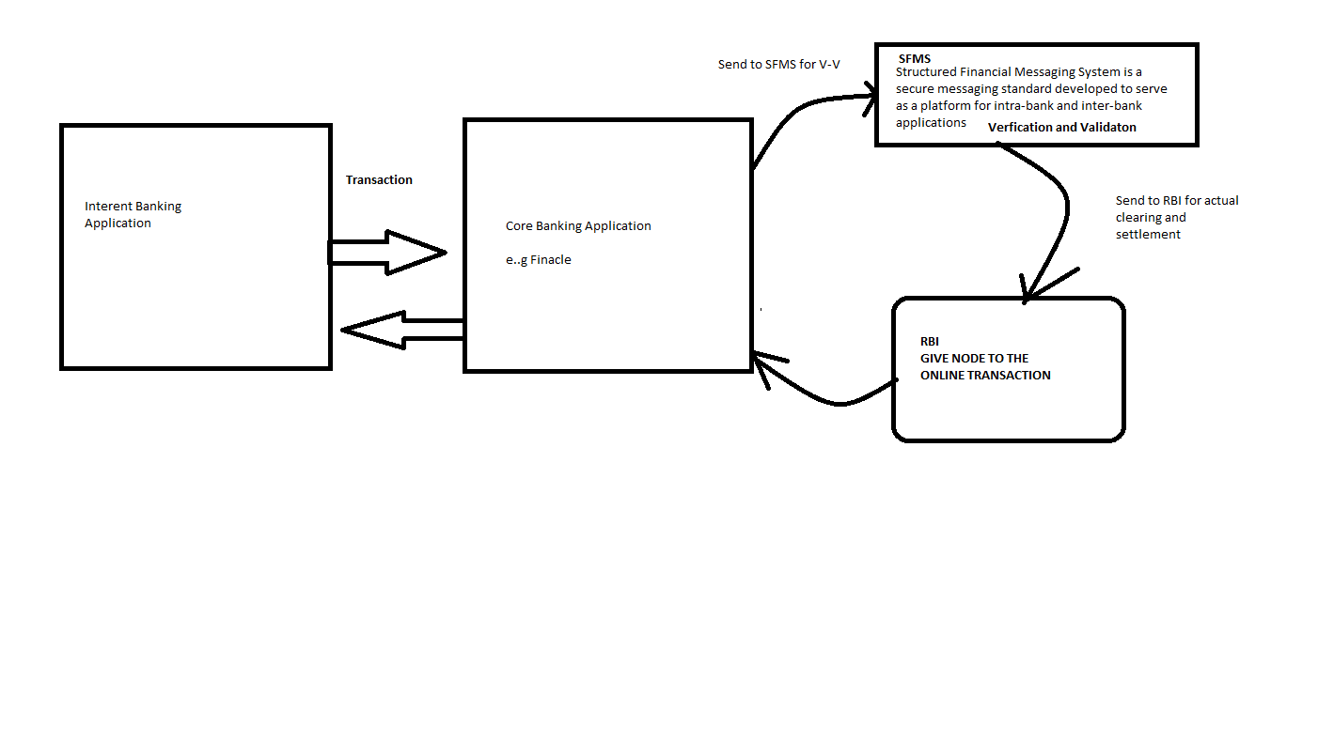
Internet Banking project flow

Slide 21
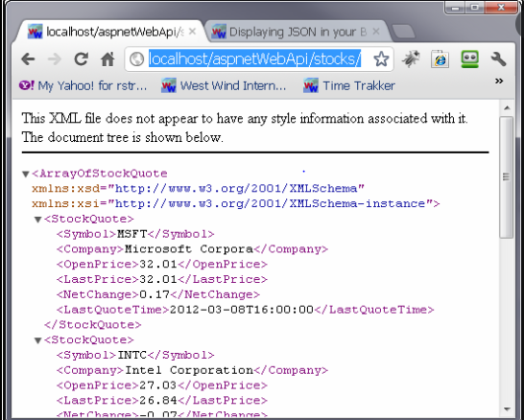

Slide 22
What is mean by Corporate internet Banking
How it is different than Retail internet banking

Slide 23
In Corporate banking there are two application
Bank Side Application
Customer side Application (BIB)

Slide 24
In bank side application we perform below task
Registered the customer CIF
Mapping the payment product with the customer
Create file format for bulk file upload
Template design
Payment Advice
We have to perform all above task to registered customer for Internet banking.

Slide 25
Other task to be perform in bank side application
Payment Enquiry
API related work ( Message Failure que)
To check payment failure
To modify the customer
We can also perform the transaction by using bank side application

Slide 26
In Customer side application we perform below task
Registered the corporate company
Set the parameter to customer
role
Create Customer user
Set Authorization Matrix

Slide 27
How we set Authorization Matrix
User | Role | Limit | Sequence
RAHUL | Checker | 1 to 5 lakhs
Sharad sir | Checker | 5.1 to 10 lakhs
Shubham sir | Checker | 10 lakh onward

Slide 28
Customer side application :
Account Information
Payment transfer
Onscreen Individual Payments transfer
Onscreen bulk payment transfer
3. Bulk File upload
a. To upload
b. Check file status field
c. Processed file
4. Transaction Inquiry:
all payments transaction detail
5. Report Module:
daily transaction report : PDF, EXCLE, TEXT
Instrument printing report: PDF, EXCLE, TEXT
Instrument status repot: : PDF, EXCLE, TEXT
6. Notification maintenance
MOBILE , email
7. Manage Payee

Slide 29
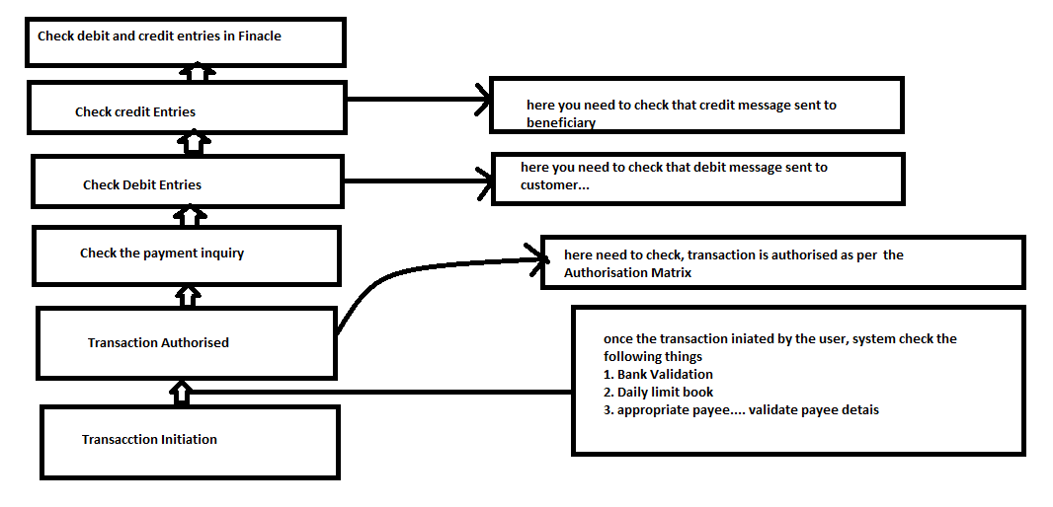
End to End flow of payment Transaction.

Slide 30
Different Types Of Testing In Internet Banking Applications:
Usability testing – Internet banking application would be used by many users- some would be technically sound and others may lack technical skills. Application should be simple so that even people who are not so much into technical side should be able to handle the application well. Website need to be tested for simple and efficient design so that any user would be able to navigate through internet banking application without assistance.
Security testing – Banking applications are the key targets of hackers and groups that commit fraudulent activities. Vulnerability scanning and penetration testing can reveal proliferation of defects and further system susceptibilities.
Functional testing – functional testing encompasses checking for all the requirements and specifications
Performance testing – Some days may have spike in banking activities – especially in festivals or period during which there is an offer. Performance failures can affect the reputation of the financial institution badly.
Database testing – This needs to be done to make sure that ensure that data integrity, data migration, validation and rules testing is fine.

Slide 31
Sample Test Cases For Net Banking Application:
Verify that user is able to login with valid username and password
Verify that user is able to perform basic financial transactions
Verify that user is able to add a beneficiary with valid name and account details
Verify that user is able to make financial transactions to added beneficiary
Verify that user is able to add decimal number into amount ( limited by 2 numbers)
Verify that user is not able to add negative number into amount field.
Verify that user is allowed to transfer money only if there is proper account balance.
Verify that there is a confirmation check for financial transactions
Verify that user is given an acknowledgment receipt upon successful financial transaction.
Verify that user is able to send money to multiple people
Verify that user is allowed to change password
Verify that account details reflect financial transactions also.
Verify that user with invalid password is not allowed to login.
Verify that after repeated attempts to login with incorrect password( as per the limits), user should be blocked.
Verify that time-out feature is implemented
Verify that if either of the username or password is blank, user is not allowed to login. User should be given an alert also.

Slide 32
Questions and answer

Slide 33
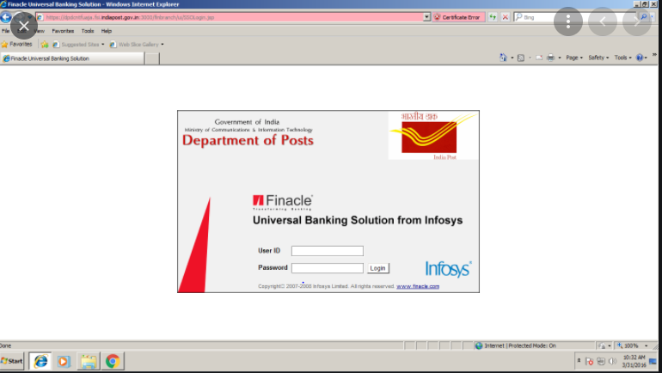

Slide 34
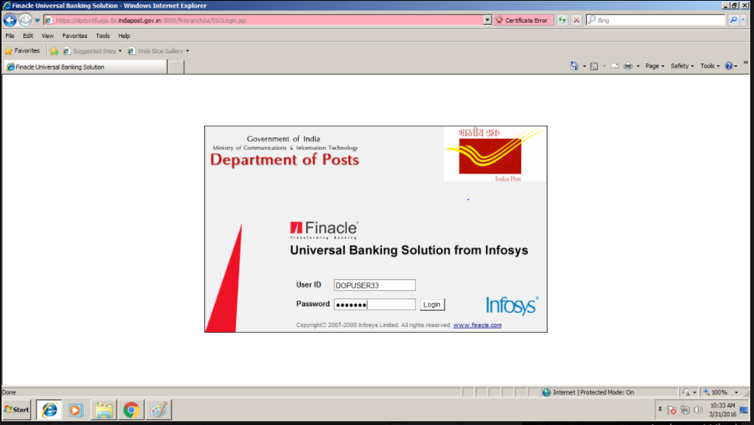

Slide 35
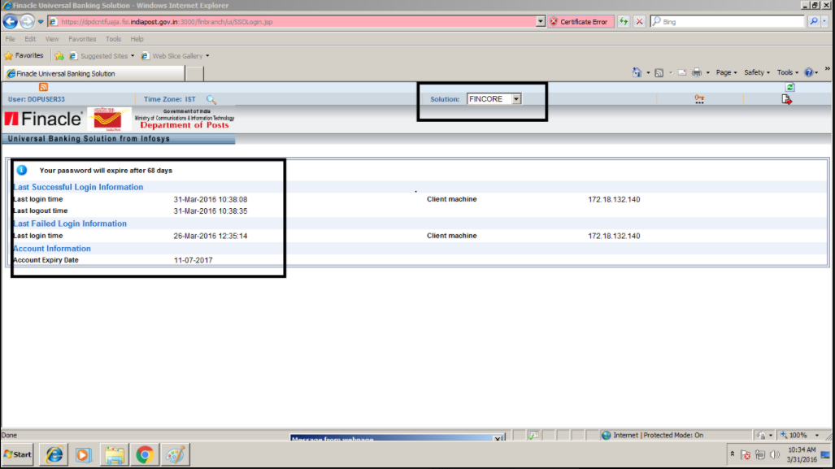

Slide 36
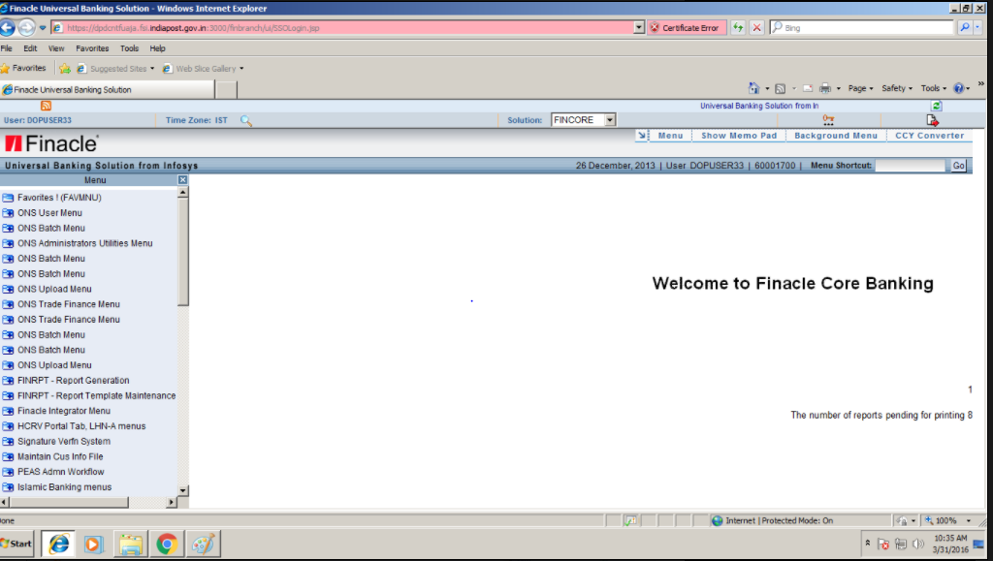

Slide 37
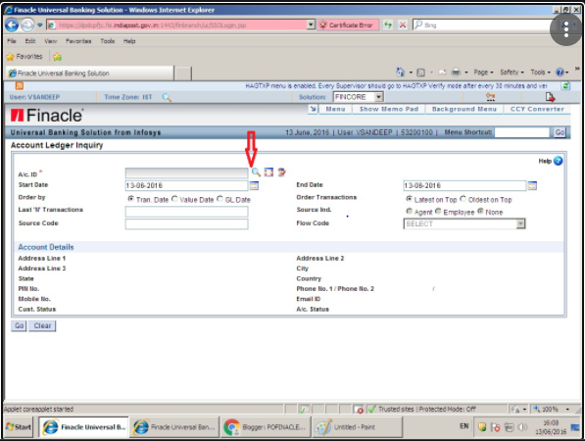

Slide 38
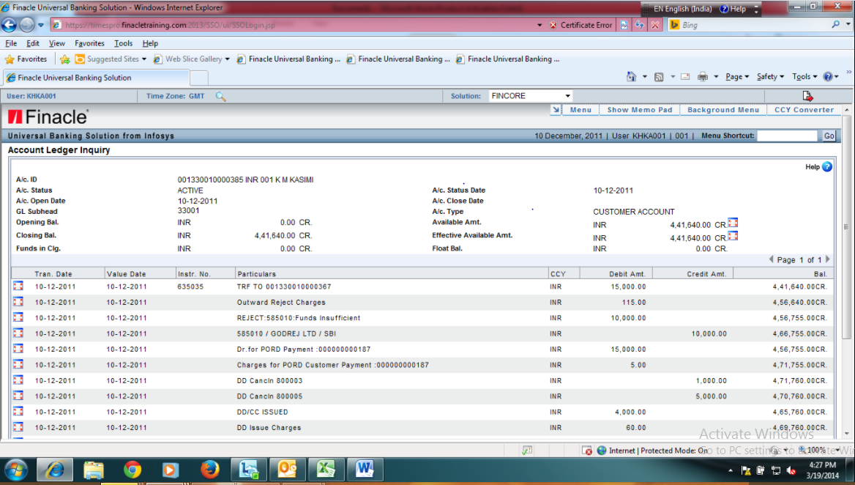

Slide 39
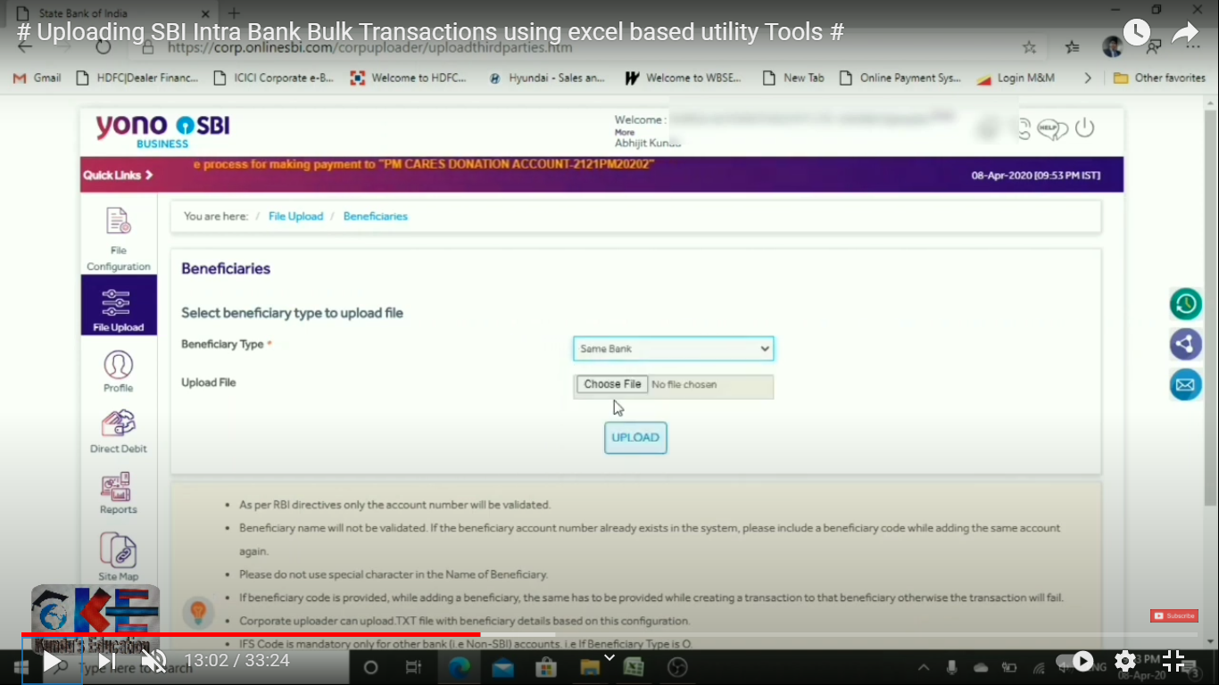

Slide 40
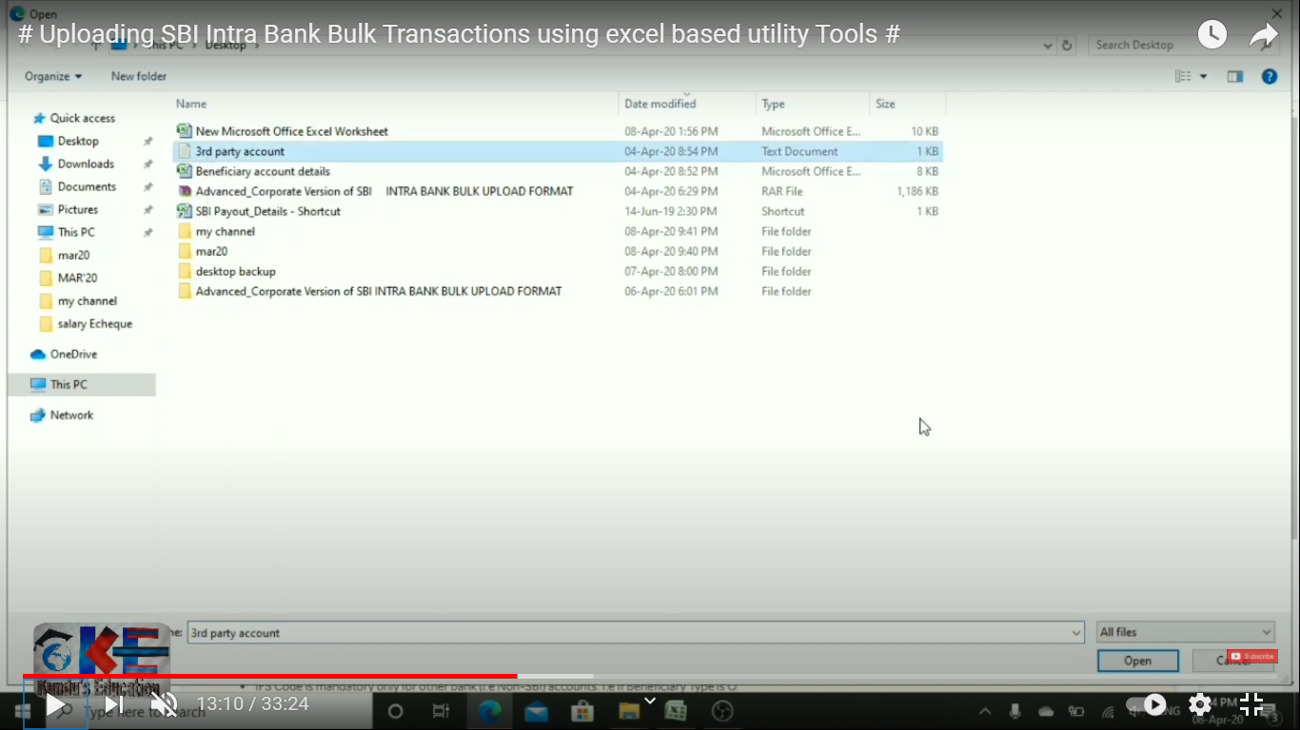

Slide 41
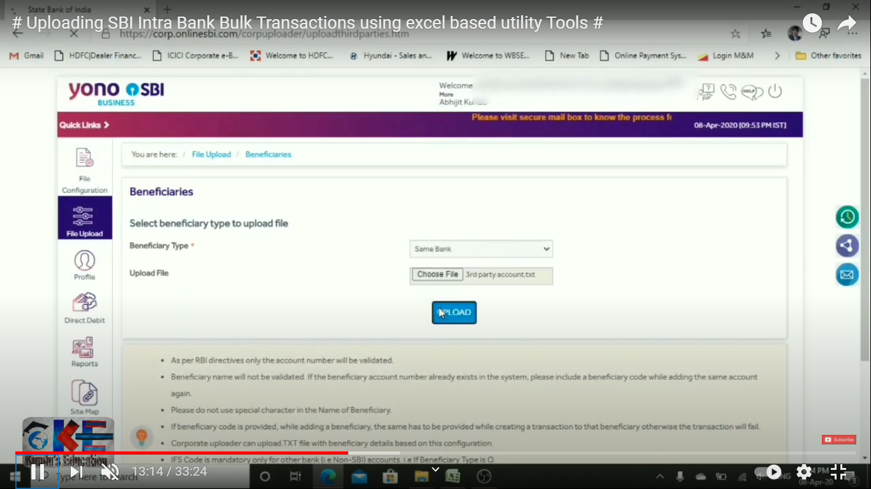

Slide 42
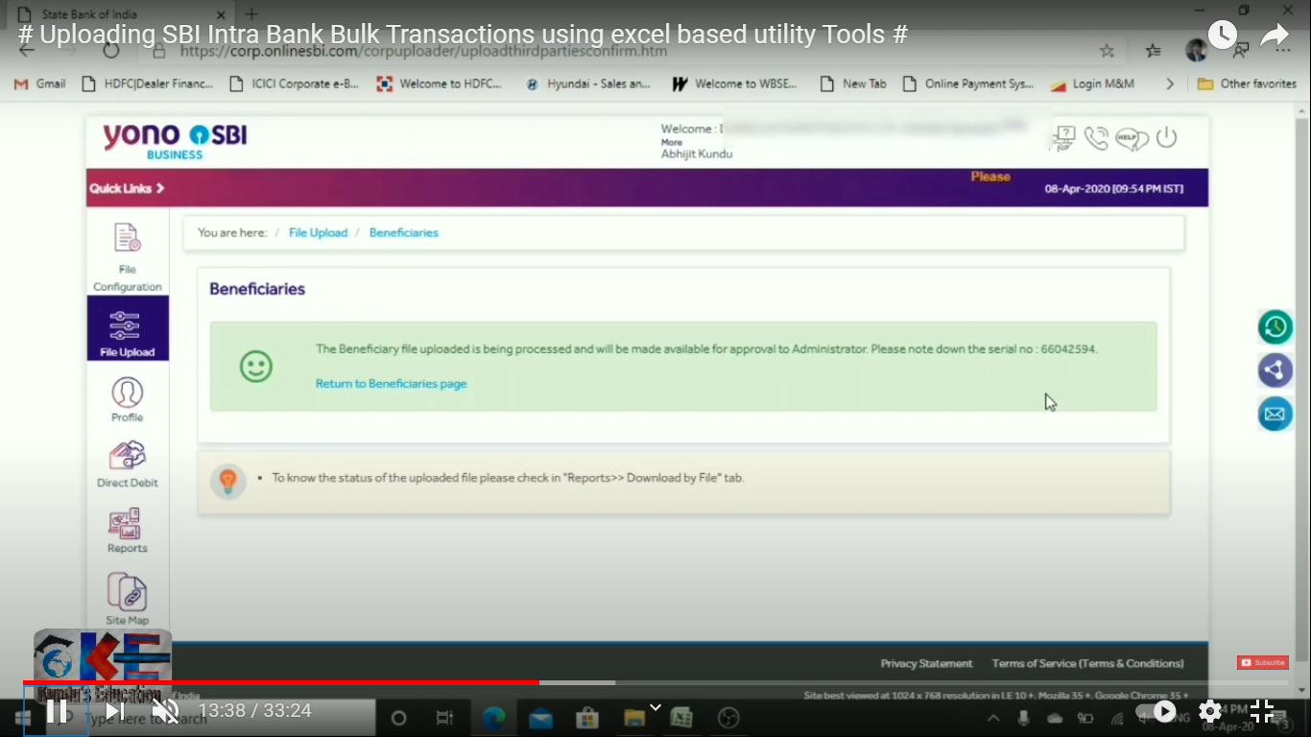

Slide 43
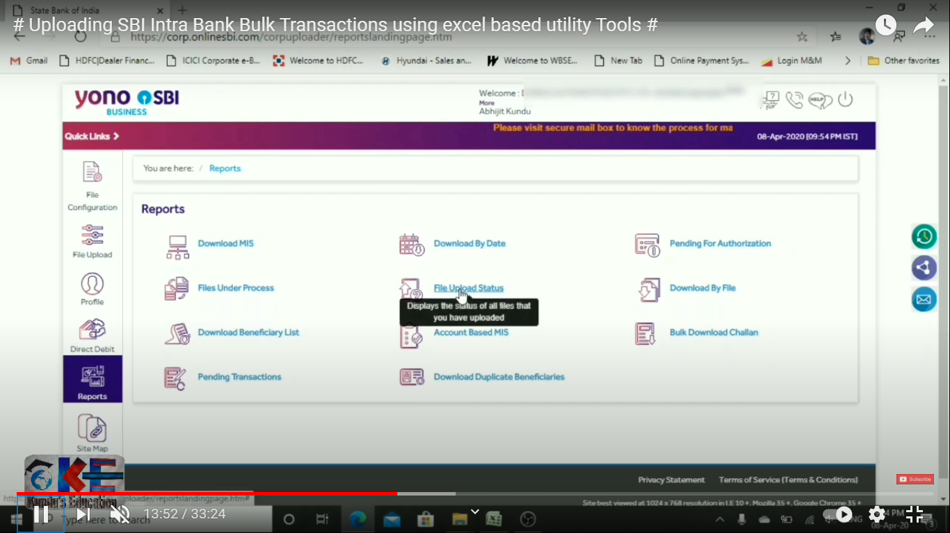

Slide 44
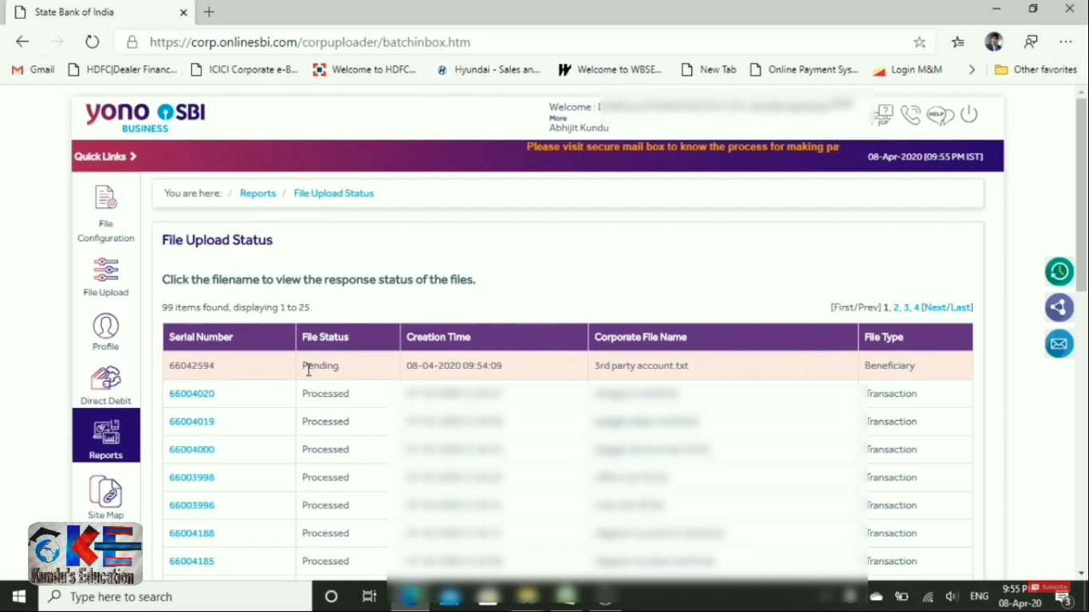

Slide 45
Interview Questions
What is your project?
What is mean by RTGS and NEFT? What is the difference between them
What are the Modules you work on?
What is mean by Authorisation Matrix? Why it needs and what are its type?
What is mean by maker and checker
What is the transaction flow?

Slide 46
7. Tell me any five scenarios on Fund transfer?
8. Explain the NEFT flow?
9. What is the difference between carporate banking and retail banking?
10. What is the difference between current account and saving account
11. What are the payment types?

Slide 47
Types of Banks:
Saving Banks
Commercial Banks
Agricultural Banks
Industrial Banks
Agricultural Banks
Central / Federal / National Bank
Co-operative Banks
Exchange Banks

